Slide 1
Project Title-SAAD
Presented by team Sujitha Ashmita Arpitha Dhimanth

Slide 2
Languages used
PHP
CSS
HTML (bootstrap)
MySQL databases (XAMPP)
JS

Slide 3
Hardware and Software requirements
Windows
Xampp
A browser (Chrome)
Code Editor (VSCode)

Slide 4
Use case
Our project aims at allowing the user to create his/her event or view the most happening events on our website and gain reach and popularity by our website and it’s thousands of potential daily users.
We let users register/login into our website and use our services

Slide 5
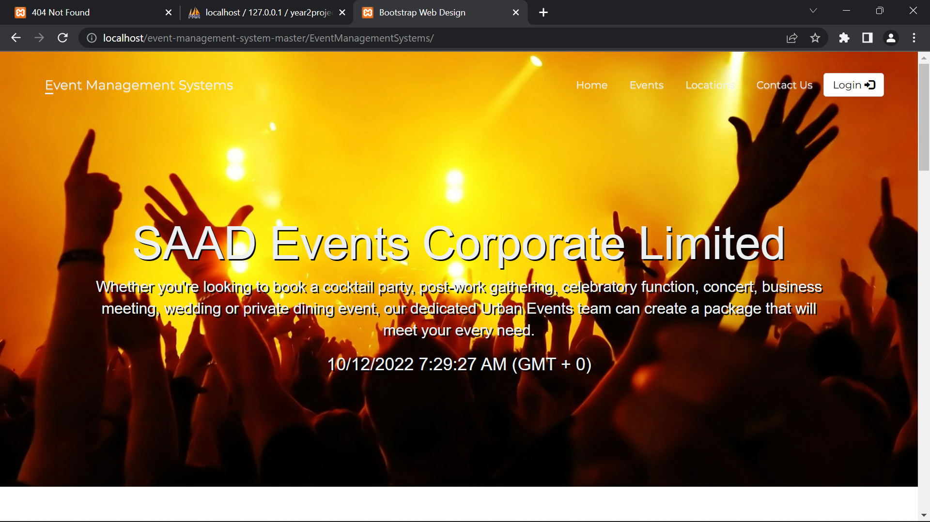
Screenshots

Slide 6
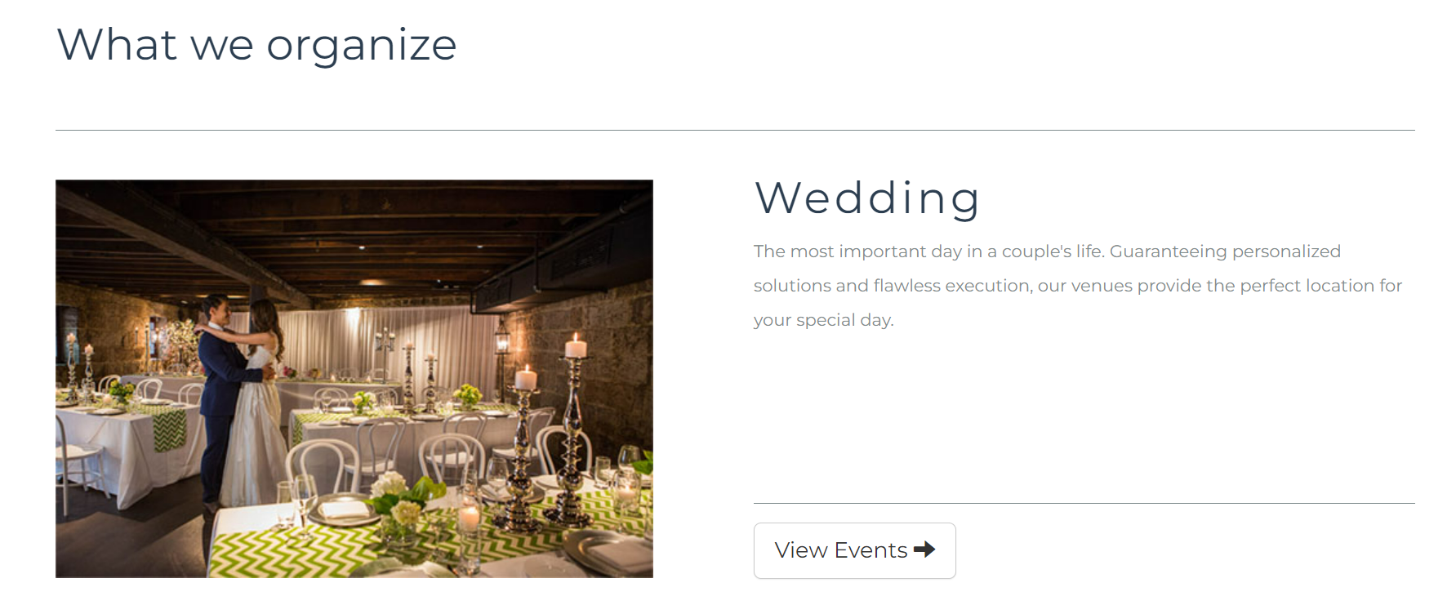

Slide 7
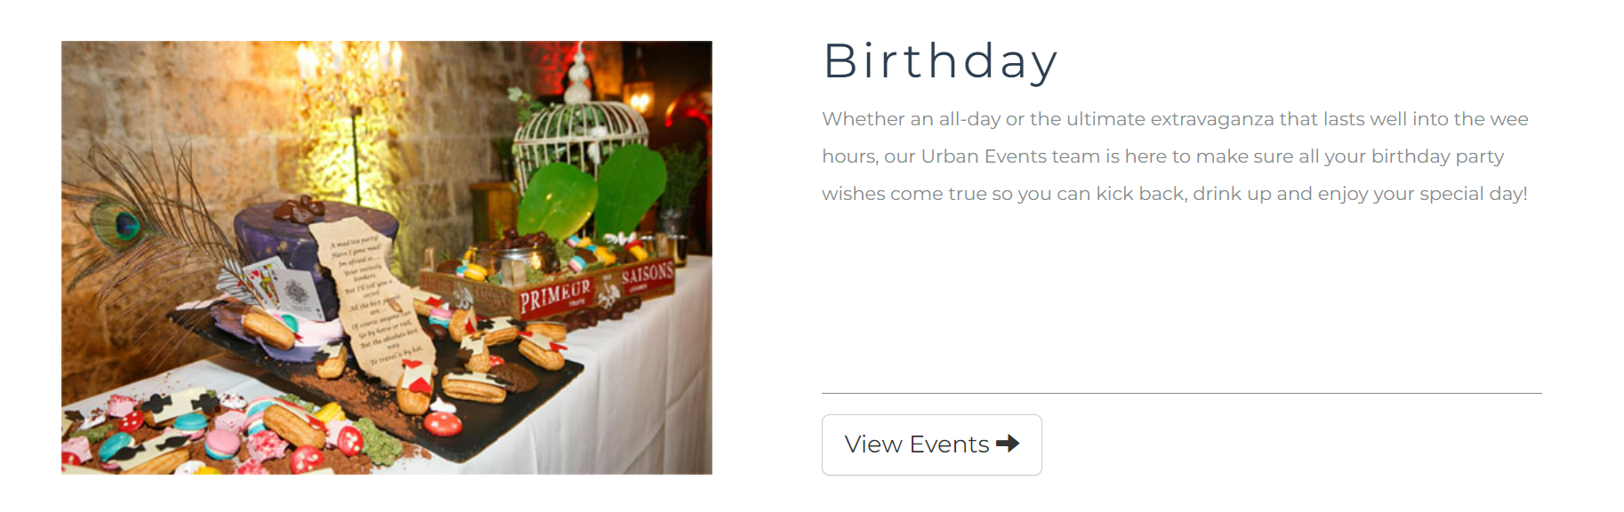

Slide 8
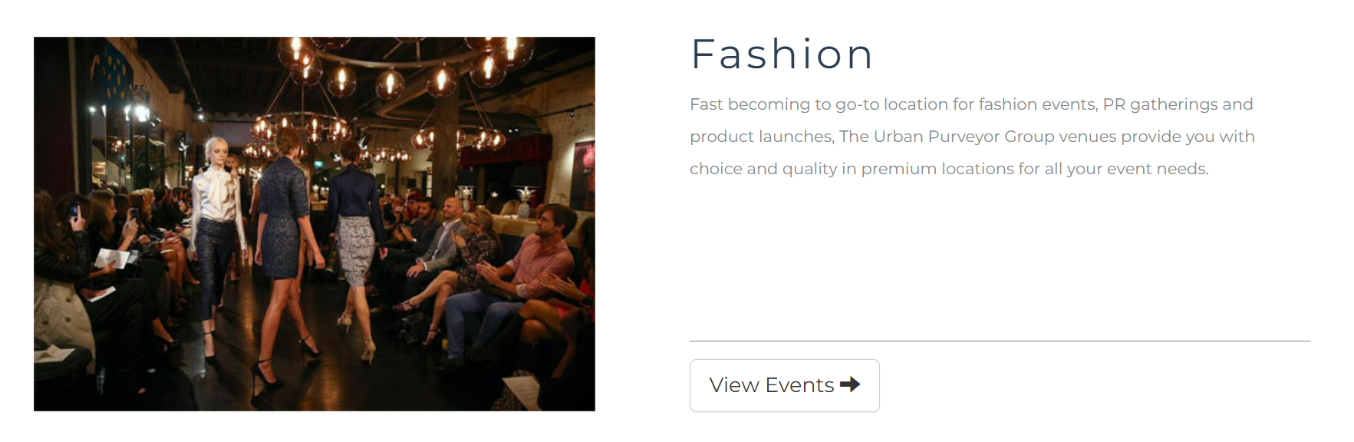

Slide 9
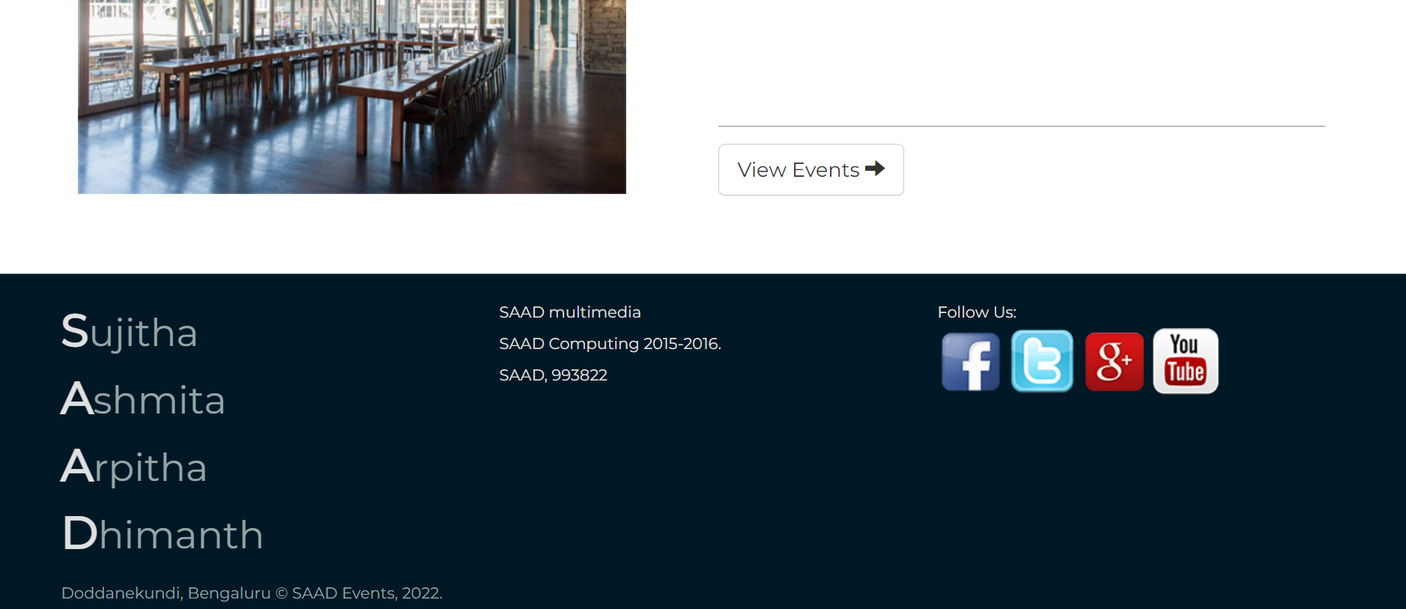

Slide 10
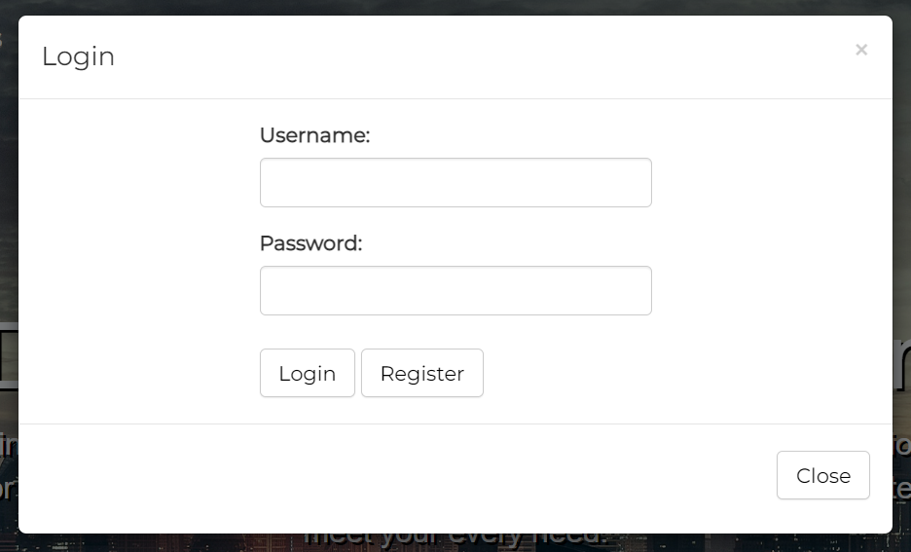
Login

Slide 11
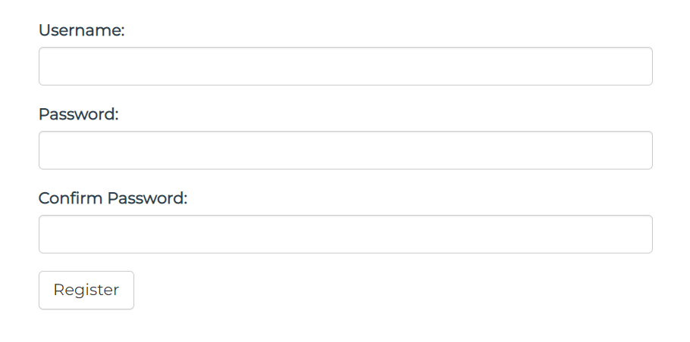
Registration of new user

Slide 12
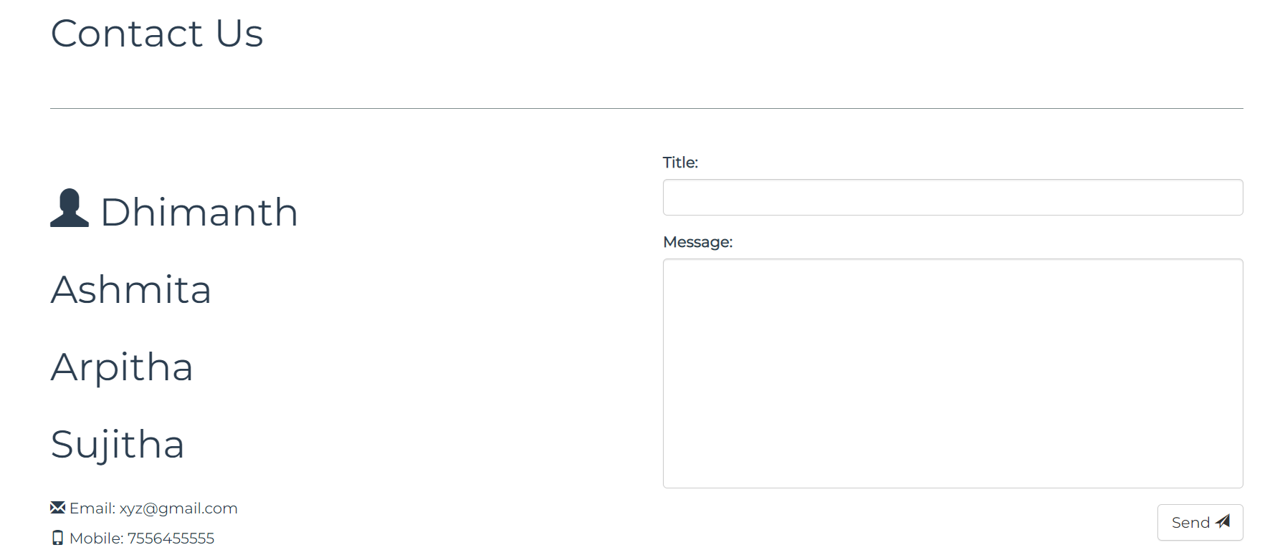
Contact us

Slide 13
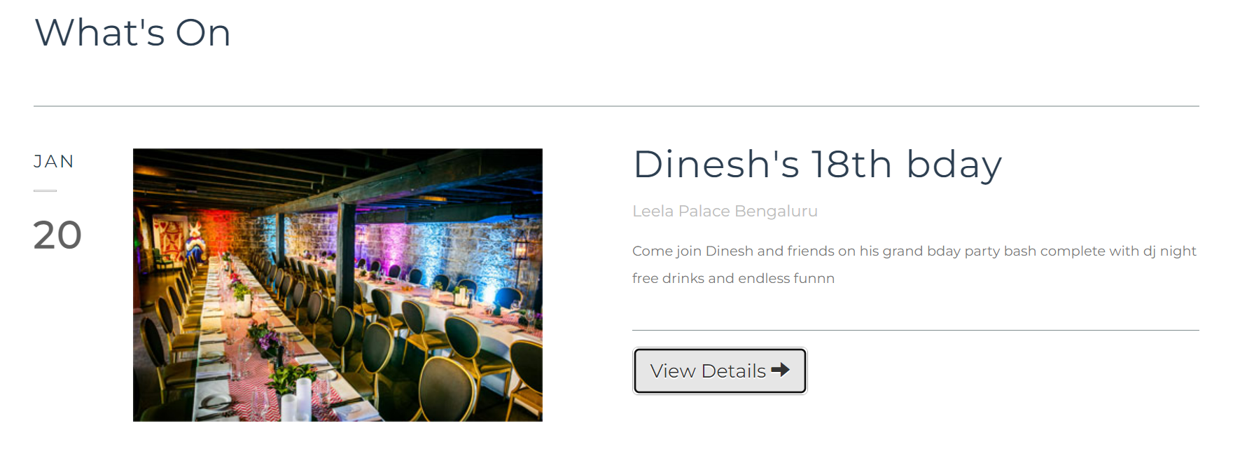
Events

Slide 14
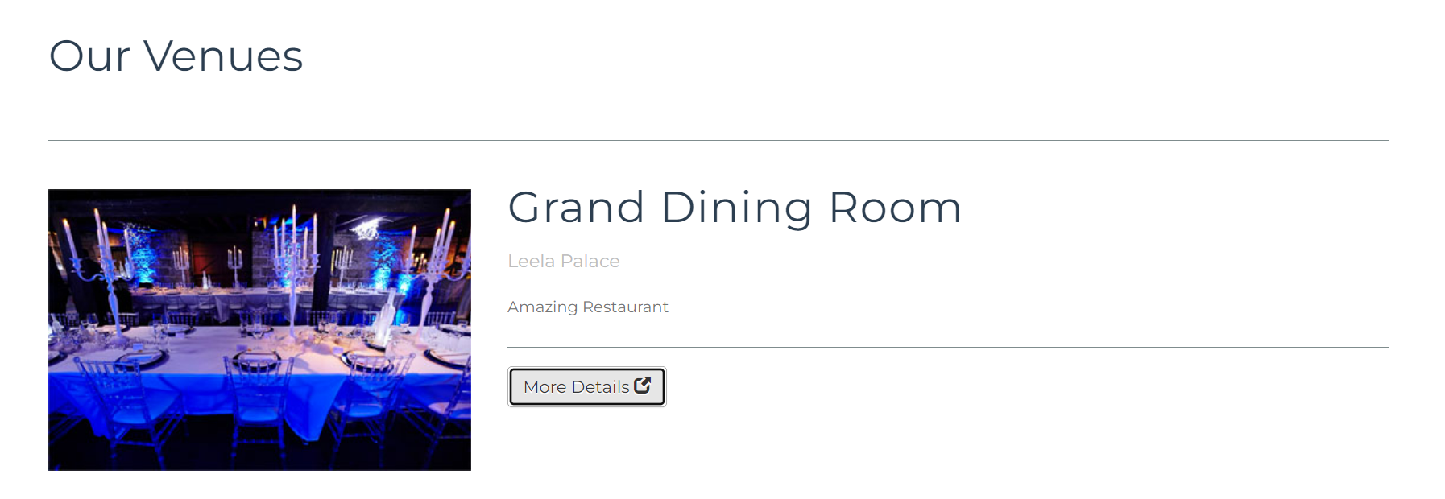
Venues

Slide 15
Future Scope of Our Project
Our project is still at a nascent stage due to certain time constraints and future backend code will be added as and when developed.
We also plan on integrating many more features into our website in the future iterations.
Some examples are :-
Implementing booking and payment interface
Linking artists to event organisers
Creating a more refined UI/UX

Slide 16
Revenue Streams and Business Strategy
We plan on running google ads on our website and keeping the basic services like viewing scheduled events free of cost
A pro membership can be availed that removes all ads and gives the user priority access to booking events, search results priority for organisers and prioritise pro users (artists) in contacting organisers through our website for gigs
10 percent commission will be charged from each organiser as an additional revenue stream
We intend to attract customers by aggressive marketing through google and youtube ads and offer them a 50 percent on first purchase sign in discount
Once we reach an appreciable userbase we plan on going global by raising VC funding

